Slide 1
Data Mining Project:
Forecast of Wine Sales
Under Covid-19
Team22: Jiyan Shi, Zhenqi Gao, Zhao Zhang

Slide 2
Objective
Build demand forecasting models
Output business and sales forecasts
Method: data mining and design of machine learning algorithms

Slide 3
Data Descrpition
Source：Database of Budweiser brewing company
Description：2 datasets，total 12 columns
Variables：Product，order，date and location informations

Slide 4
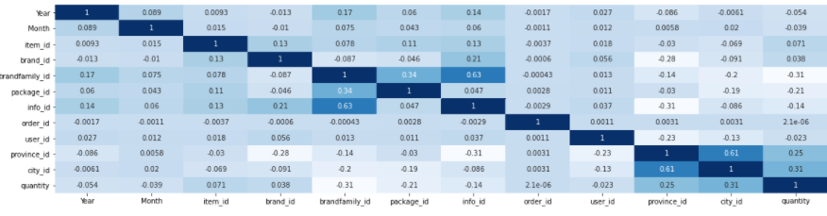
EDA

Slide 5
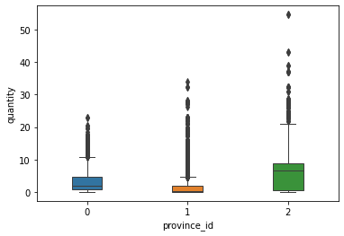
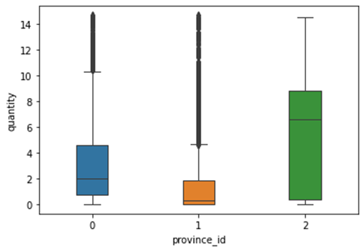
EDA

Slide 6
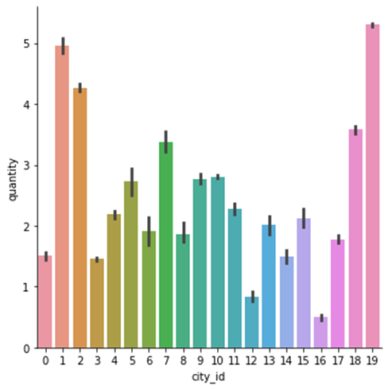
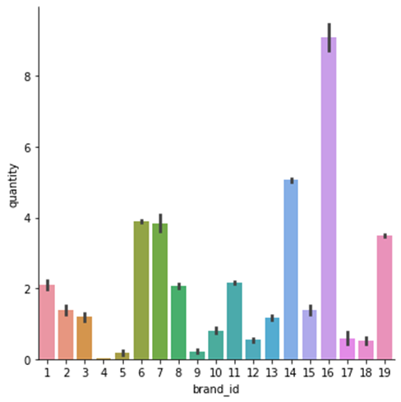
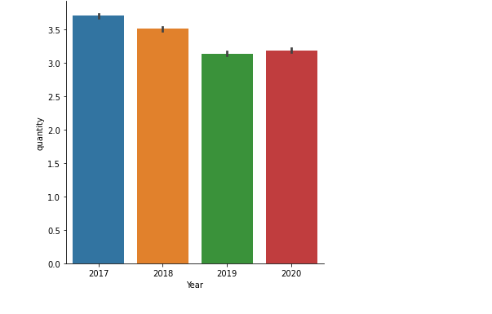
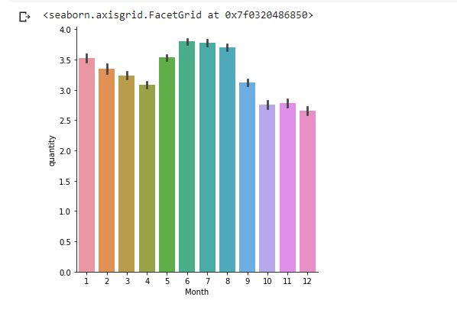
EDA

Slide 7
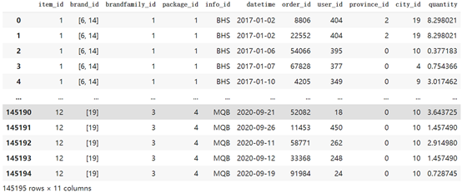
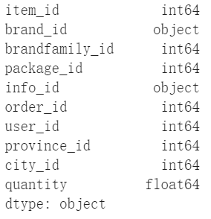
Data Preprocessing
Interact with datasets
Check data types
Check missing value

Slide 8
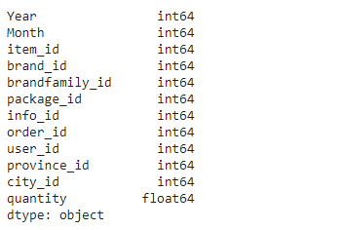
Variable Selection
Final dtype
Handle Time Series Data:Change datetime into index
Add Month(datetime) Year(datetime） as new columns
Features and Targets split:
Features = [‘Year’, ‘Month’, ‘item_id’, ‘brand_id’, ‘brandfamily_id’, ‘package_id’, ‘info_id’, ‘order_id’, ‘user_id’, ‘province_id’, ‘city_id’]
Targets = [‘quantity’]

Slide 9
Data Mining Tasks
Prediction (Regression Methods)
Time Series Forecast (Use previous years to predict later years)
Reference Method:(TextBook)Data Mining for Business Analytics Concepts, Techniques and Applications in Python Chpter 16
Train and Validation Split:
Train: df[‘Year’] == 2017, 2018 , 2019 (157269,12)
Validation: df[‘Year’] == 2020 (60454,12)
Evaluation Metrics: MAE, RMSE
Time Series Visulization

Slide 10
Model Build (with tuning hyperparameters)
KNN
k :int
weights:[uniform, distance]
algorithm:[auto,bell_tree, kd_tree, brute]
RandomForest
max_Depth:int
n_estimators:int
Nerual Network
learning_rate:float
transfer_function:Identity, logistic, tanh,relu
Multiple Linear Regression
(Normal, Lasso, Ridge)
alpha:float
fit_intercept:[True,False]
normalize::[True,False]
LightGBM
num_leaves:int
learning_rate:float

Slide 11



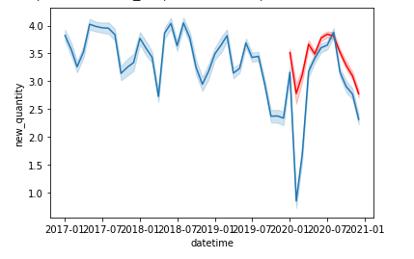
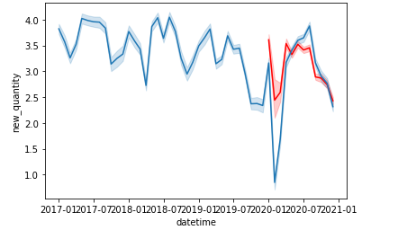
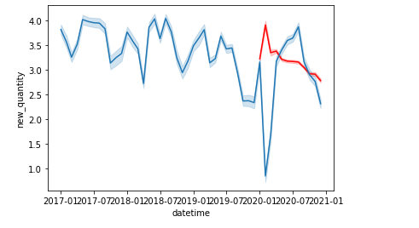


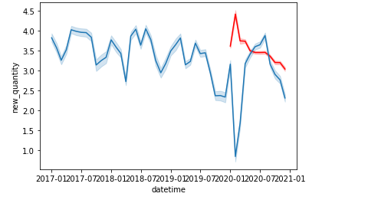
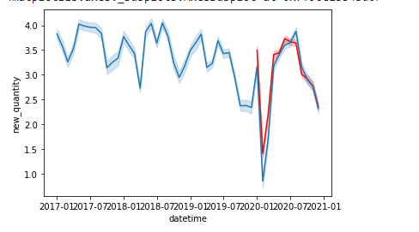
Prediction Results
KNN
Random Forest
Linear Regression
LightGBM
Nerual Network

Slide 12
Thank you!
Question?

